Slide 1
Visualizing “Alice”
Erifili Kokkalidou | eri.kokkalidou@gmail.com
Alexander Technological Educational Institute of Thessaloniki
“Information Visualization in Humanities “
23-24 March 2017 | Torun, Poland

Slide 2
Introduction
In 2015, the British Library celebrated “Alice’s Day” (4 July 2015), which commemorates the favorite children’s book “Alice’s Adventures in Wonderland” by Lewis Carroll. To accompany the event, the British Library created a dataset comprising of records for works related to “Alice in Wonderland”, from the BNB and the British Library printed and manuscript collections. The dataset is updated annually. This presentation showcases visualizations created using the aforementioned dataset. Specifically, the visualizations present information about the topics and genre of the works related to “Alice in Wonderland”, the years and places of their publication, as well as the type of the publications and the people related to them.

Slide 3
Methodology
The process of creating the project is the following:
Discovery of the dataset at the BL website
Conversion of .csv dataset file to Excel (.xlsx) file
Cleaning of the data contained in the dataset
Removed duplicates
Applied CLEAN, TRIM and PROPER functions to .xlsx file
Topics: Decided to only keep the broader available term, discarded the narrower terms
Dates of creation/publication: Applied a common date format (e.g. 1904)
Creation of visualizations using the “Tableau Public” software

Slide 4
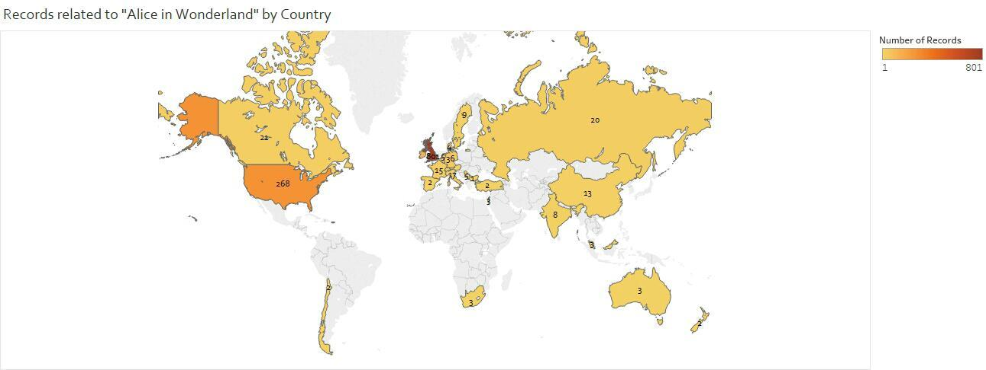
Records by Country

Slide 5
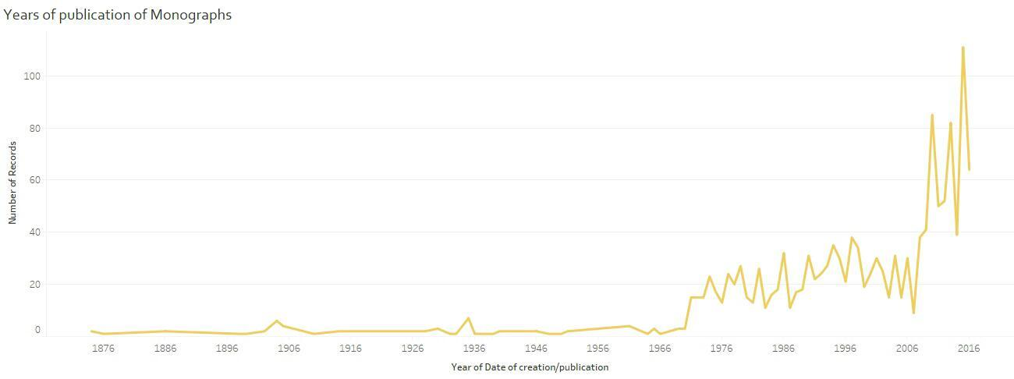
Years of publication (monographs)

Slide 6
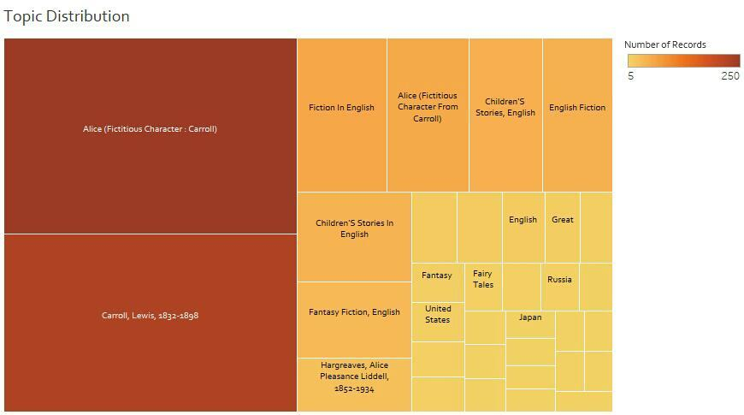
Topics Distribution

Slide 7
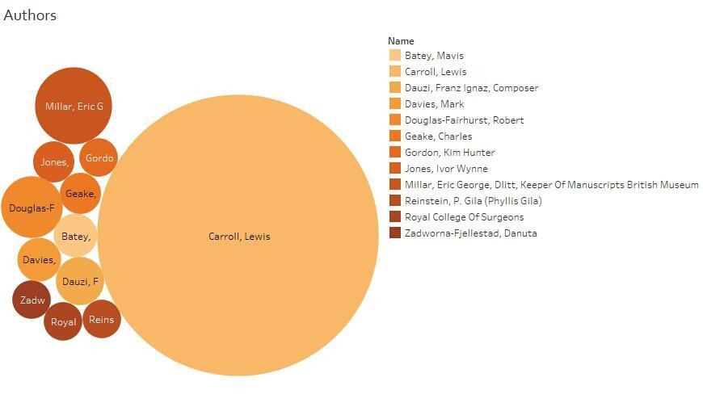
Authors

Slide 8
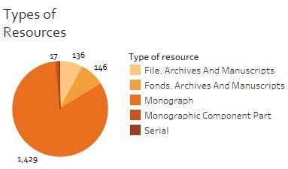
Resources

Slide 9
Conclusions
Country with the most publications: United Kingdom. (Other countries: USA, Ireland)
Up to 1970: few monographs related to “Alice in Wonderland”. 1070-2009: number increases. 2009-2016: peak.
Most common subject headings: “Alice (Fictious Character : Carroll)” and “Carroll, Lewis, 1832-1898”. (Less frequently used SH: “Fiction in English“, “Children’s Stories in English”, “Fantasy Fiction, English” and “Hargreaves, Alice Pleasance Liddell, 1852-1934”).
Author with most works: Lewis Carroll (374, contains translations). Other authors: Eric George Millar, Robert Douglas Fairhurst.
Majority of records: Monographs.

Slide 10
Thank you
Erifili Kokkalidou | eri.kokkalidou@gmail.com
Department of Library Science an Information Systems
Alexander Technological Educational Institute of Thessaloniki
Interactive visualizations can be found here: https://public.tableau.com/profile/eri.kokkalidou#!/vizhome/VisualizingAlice/Countries

